Slide 1
Bidding System

Slide 2
Short summary
A bidding system where users are able to create bids on products until a timer runs out.

Slide 3
Tech stack
Tech | Reason
Scala | Easy async handling of requests
Play framework | Popular web framework for routing to scala backend (not using build-in webserver)
Nginx | Popular high performance Web server for handling lots of request (Instead of play because of fault tolerance)
Angular | Well documented framework, used in implementing SPA requirement
Cassandra | Good performance on bids as time series data (more pushing less pulling data).
MongoDB | Storage of products, mongodb has a scala driver
Kubernetes | For orchestration of docker containers

Slide 4
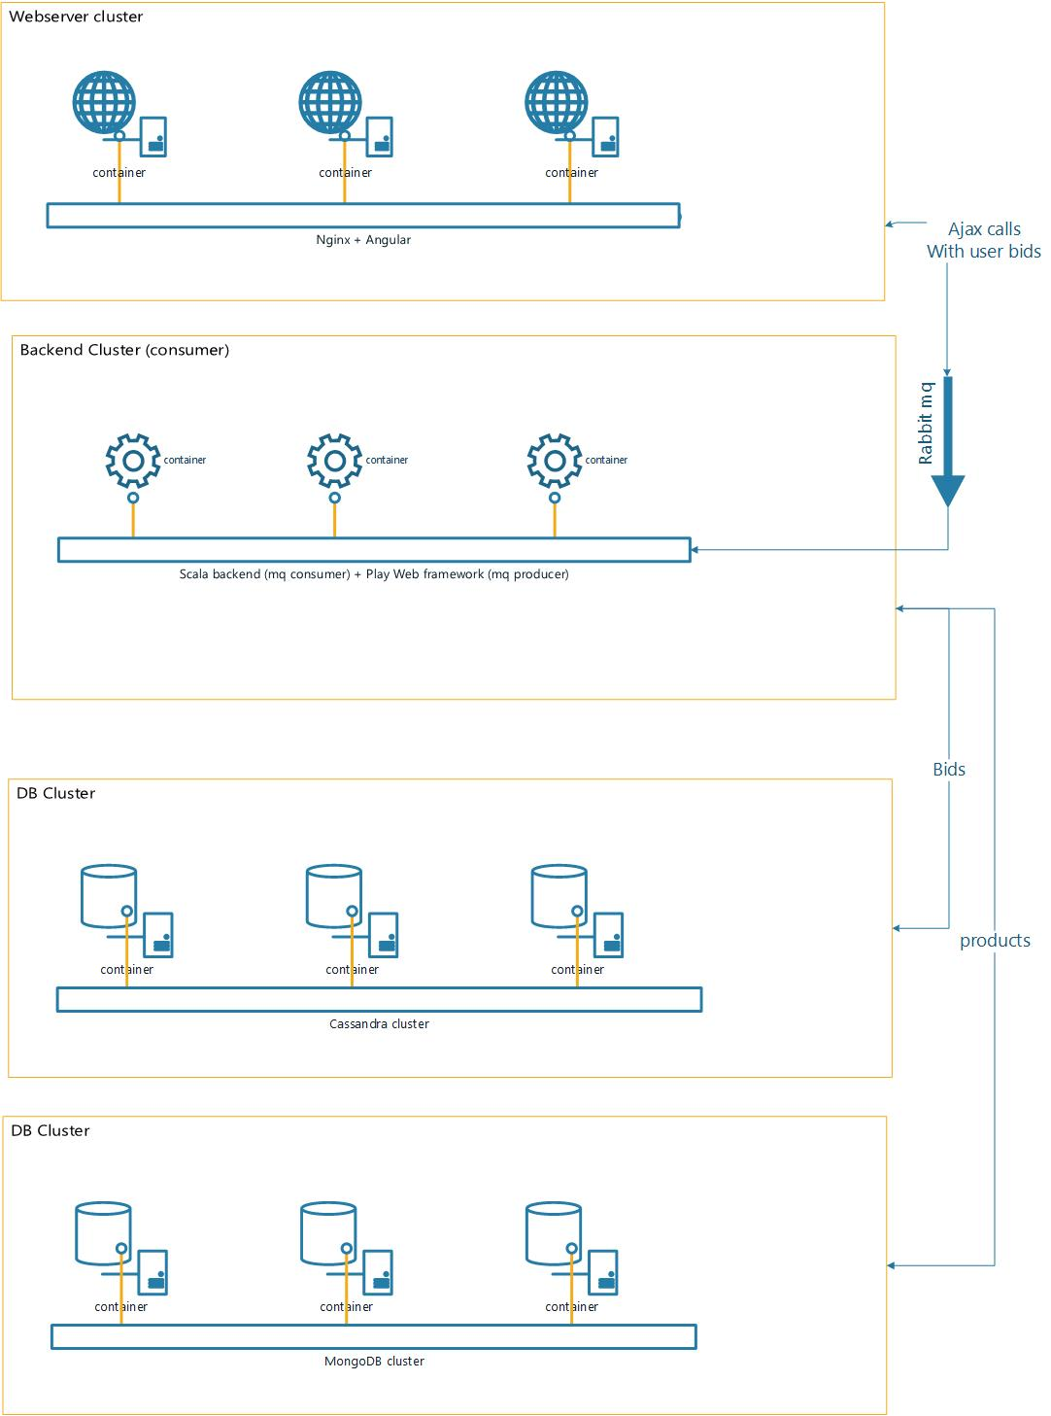
Structure
All main tasks containerized and split.
Orchestrated by Kubernetes
Rabbitmq for handling spikes in bids
Hopefully implementing a Admin Dashboard

